Slide 1

S3 Case Study Project
Group 10: Francisco Marcó
Kaloyan Andreev
Sava Vasilev
A flight management infrastructure solution

Slide 2


Agenda
Introduction
Project definition
Architecture definition
Financial analysis
Demo
Conclusion

Slide 3
Introduction

Slide 4


Our solution
IaaS to provide flights for our clients
Allow bookings, scheduling, flight management
Manage payments and user information
Provide an easy, accessible experience to travelers and tourists

Slide 5




User Requirements Specifications
Simplify and speed up internal operations for a more efficient pipeline
Ensure customer success experience with CS tools
Save up money and time
Secure Cloud based environment

Slide 6
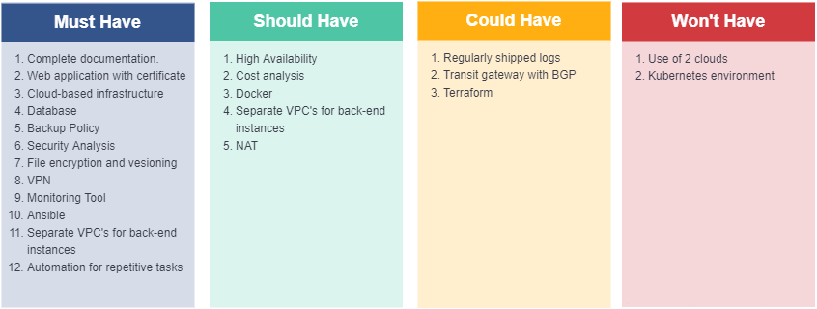
MoSCoW Table

Slide 7

Documentation
Project plan
Design document
Process report
User Personas
User manual
More planned to fit implemented functionalities

Slide 8
Architecture Definition

Slide 9


Functionalities
Monitor servers’ metrics to ensure the service
Secure, stable, scalable network in AWS
High Availability
Web application deployment
Backup policies, logging
Security measures
Automation

Slide 10
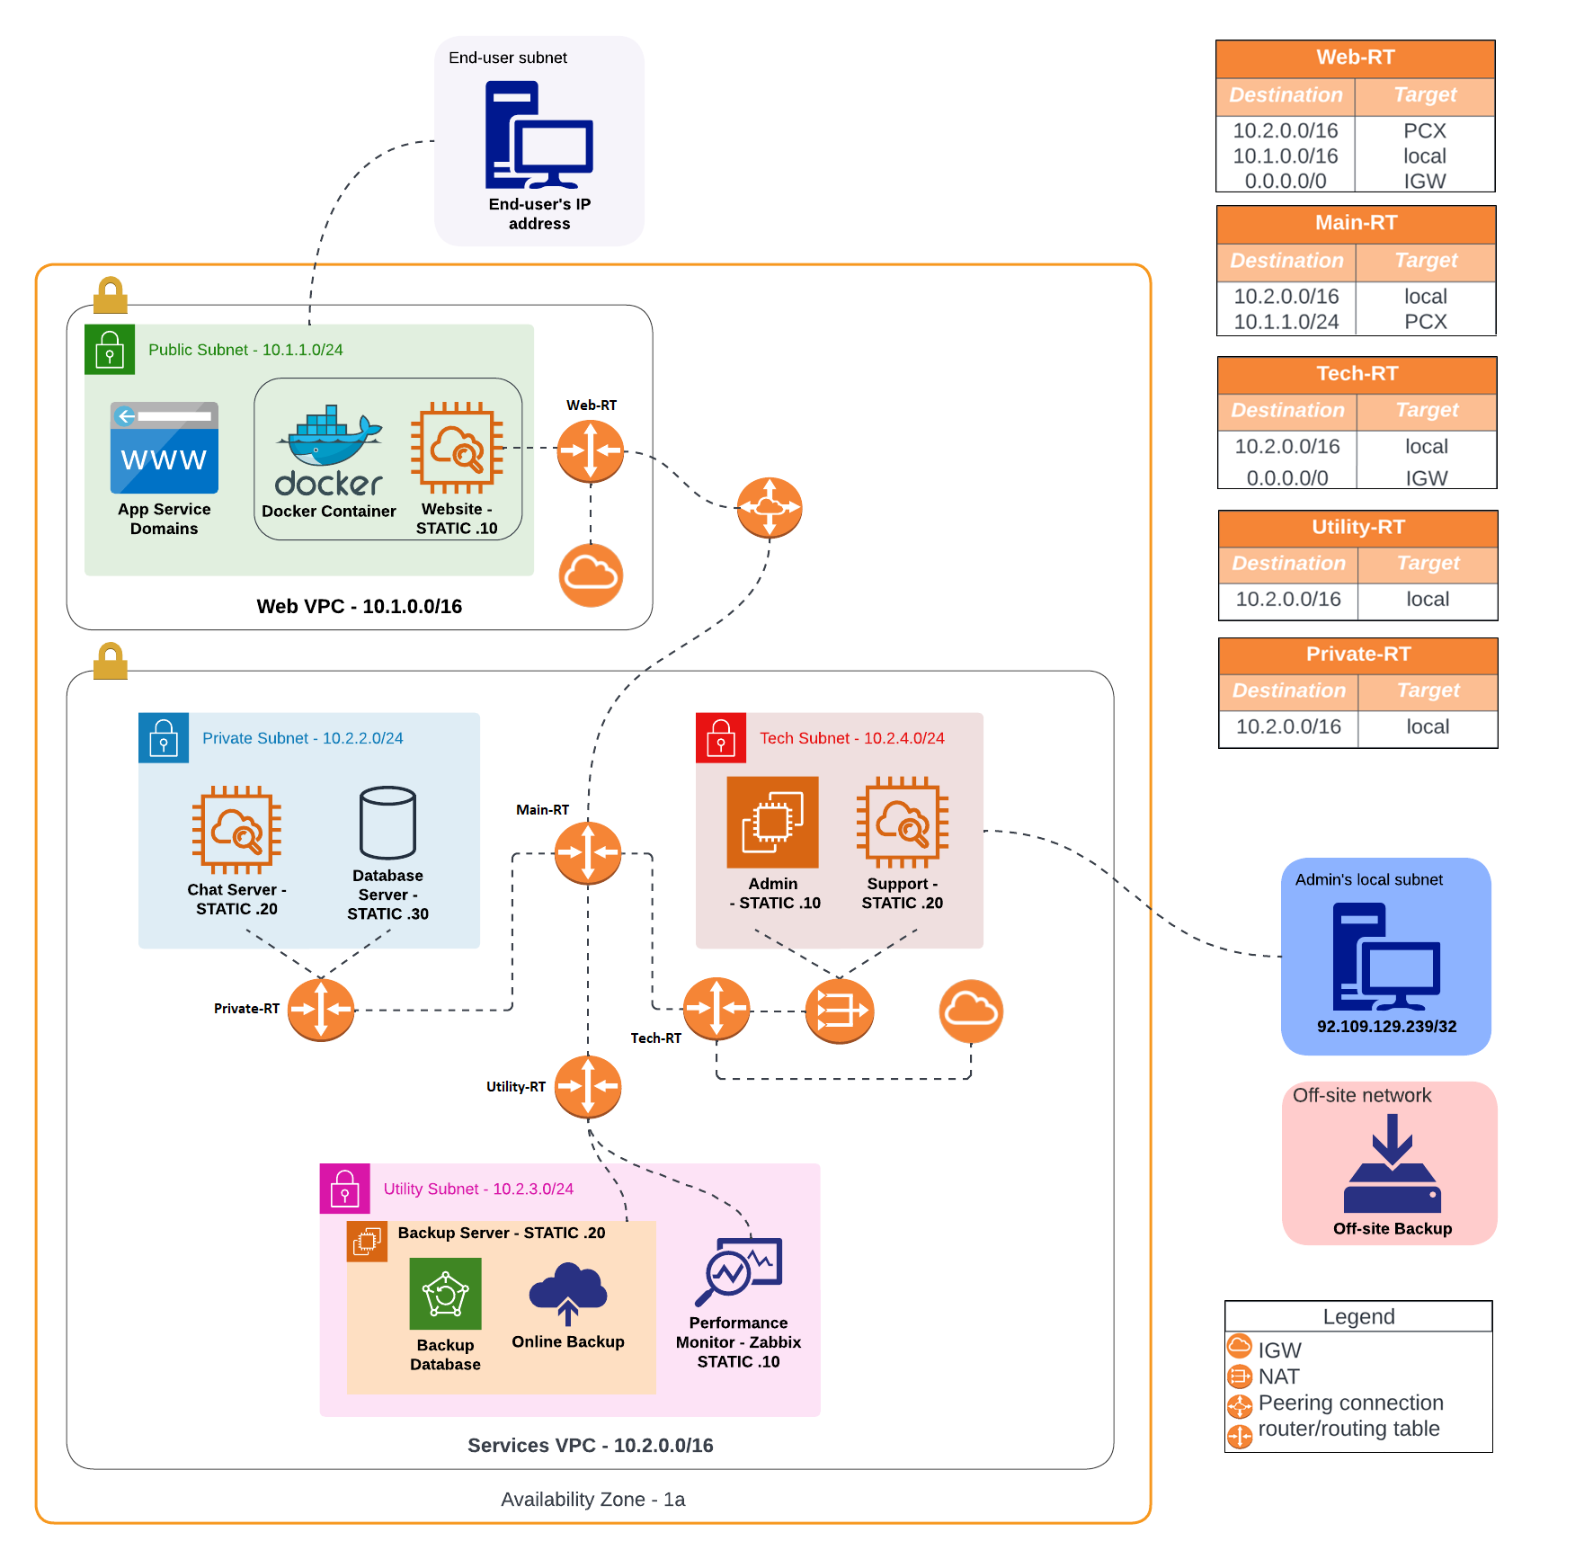

Slide 11
Financial Analysis

Slide 12
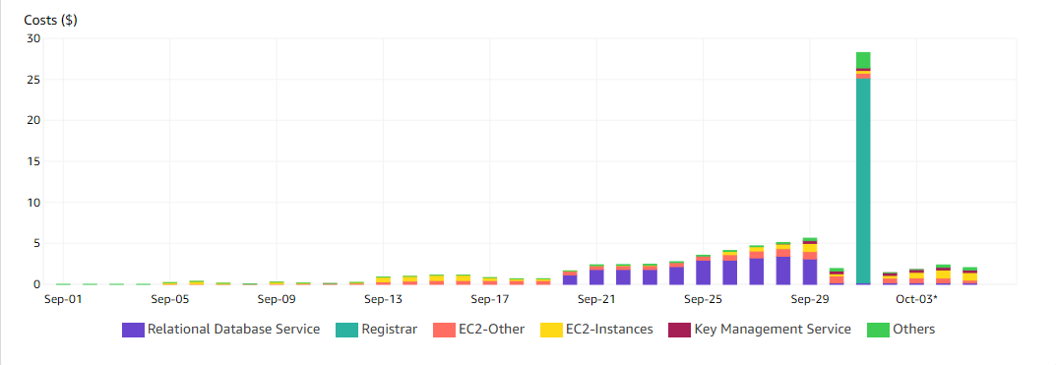
Costs by Service

Slide 13
Steps to take next
Use AWS Budgets to set up cashflow and determine costs of operations
Elaborate Financial Report document

Slide 14
Demo

Slide 15
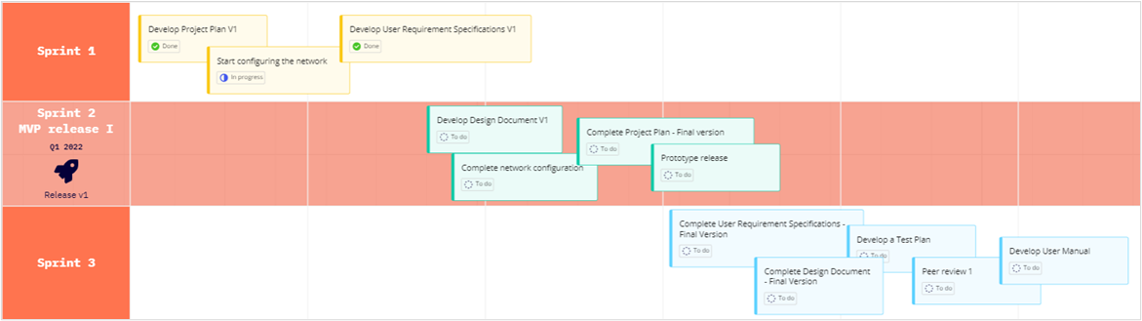
Product Roadmap

Slide 16
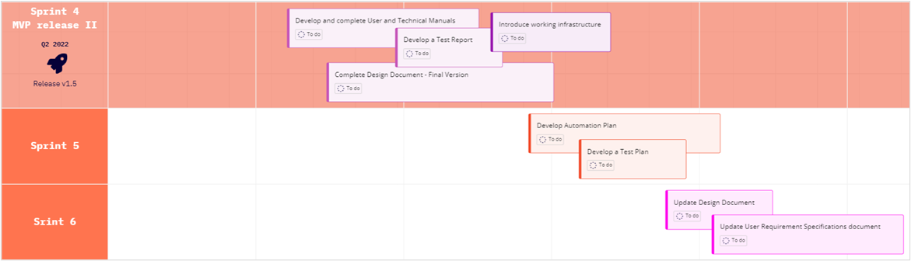
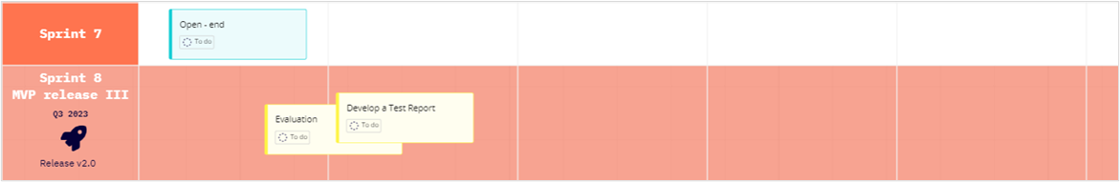

Slide 17
Conclusion

